Slide 1
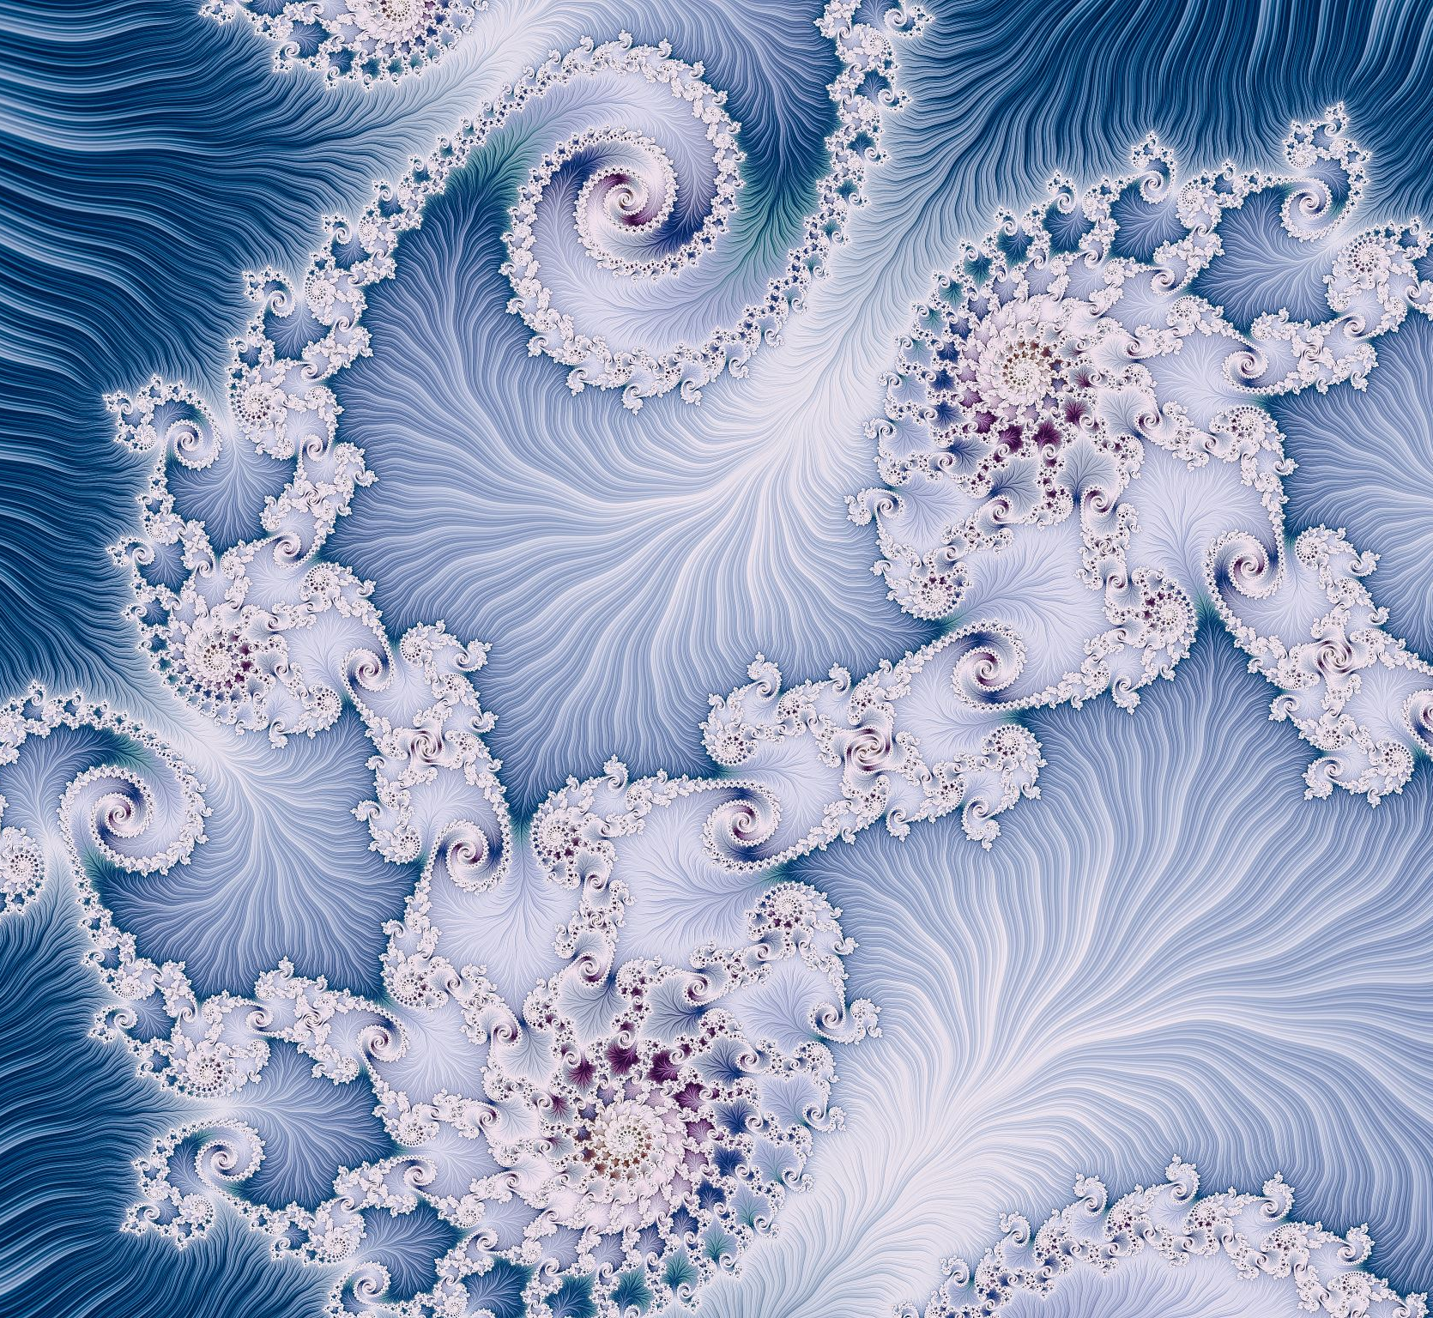
Computer Graphics
Week 2: 2D Graphics (1)

Slide 2
Today’s Topics
Pixels, Coordinates, and Colors
Shapes
Transforms
Pixel Coordinates
Real-number Coordinate Systems
Aspect Ratio
Color Models
Viewing and Modeling
Translation
Rotation
Combining Transformations
Scaling
Matrices and Vectors

Slide 3
Pixels, Coordinates, and Colors
Pixel Coordinates
Real-number Coordinate Systems
Aspect Ratio
Color Models

Slide 4
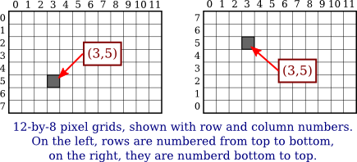
Pixel Coordinates
Notes:
Row and column numbers identify a pixel, not a point. A pixel contains many points.
The goal of computer graphics is not really to color pixels—it is to create and manipulate images.
A diagonal geometric line will cover some pixels only partially. It is not possible to make part of a pixel black and part of it white.

Slide 5
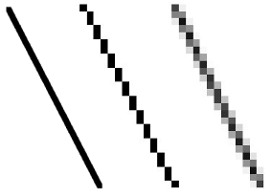
Aliasing
When you try to draw a line with black and white pixels only, the result is a jagged staircase effect
Notes:
When you try to represent the image using pixels, many real-number coordinates will map to the same integer pixel coordinates; they can all be considered as different names or "aliases" for the same pixel

Slide 6
Antialiasing
Techniques to mitigate the effects of aliasing
When a pixel is only partially covered by a shape, the color of the pixel should be a mixture of the color of the shape and the color of the background
(left): a geometric line
(middle): the line is drawn without antialiasing
(right): the line is drawn using antialiasing
Notes:
antialiasing does not give a perfect image, but it can reduce the "jaggies" that are caused by aliasing

Slide 7

Issues with Mapping Real-number Coordinates to Pixels
Two lines drawn using HTML Canvas Graphics
  Top: the line was drawn from (100, 100) to (120, 100)
  Bottom: the line was drawn from (100.5, 100.5) to (120.5, 100.5)
In canvas graphics, integer coordinates corresponding to the lines between pixels
So for the top line, the line is drawn half in one row of pixels and half in another row. The graphics system, which uses antialiasing, rendered the line by coloring both rows of pixels gray.
Other graphics systems might render the same lines differently.

Slide 8
Pixel Magnifier Demo
Demo Title.html
Notes:
Demo Title (hws.edu)

Slide 9
Problems with Pixel Coordinates
Earlier, individual pixels were clearly visible
Now, at the highest resolutions, individual pixels can no longer be distinguished
Pixels come in a range of sizes, so we cannot use coordinate systems based on pixels
  An image created assuming that there are 100 pixels per inch will look tiny on a 400 PPI display
  A one-pixel-wide line looks good at 100 PPI, but at 400 PPI, a one-pixel-wide line is probably too thin
Fortunately, they are less of a problem for vector graphics
  The vector image can be created using any convenient coordinate system

Slide 10
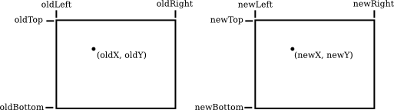
Real-number Coordinate Systems
In 2D graphics, we are given a rectangle in which we want to draw some graphics primitives
To specify the coordinate system on a rectangle, specify the horizontal coordinates for the left and right edges of the rectangle and the vertical coordinates for the top and bottom
Given coordinates for a point in one coordinate system, we want to find the coordinates for the same point in a second coordinate system
Suppose that the horizontal and vertical limits are oldLeft, oldRight, oldTop, and oldBottom for the first coordinate system, and are newLeft, newRight, newTop, and newBottom for the second
Formulas for newX and newY are then given by
  newX = newLeft +
  ((oldX - oldLeft) / (oldRight - oldLeft)) * (newRight - newLeft))
  newY = newTop +
  ((oldY - oldTop) / (oldBottom - oldTop)) * (newBotom - newTop)
In practice, though, you won't usually have to do the transformations yourself, since most graphics APIs provide some higher-level way to specify transforms

Slide 11
Real-number Coordinate Systems
suppose that we want to transform some real-number coordinate system with limits left, right, top, and bottom into pixel coordinates that range from 0 at left to 800 at the right and from 0 at the top 600 at the bottom
  newX = ((oldX - left) / (right - left)) * 800
  newY = ((oldY - top) / (bottom - top)) * 600
In practice, though, you won't usually have to do the transformations yourself, since most graphics APIs provide some higher-level way to specify transforms

Slide 12
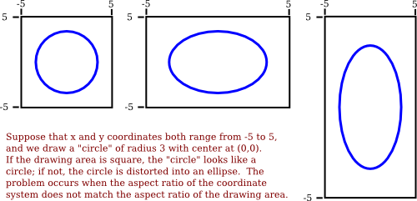
Aspect Ratio: The ratio of its width to its height
What is the width of a rectangle with aspect ratio of 5/4, given its height of 600?
If the horizontal and vertical limits for the coordinate system are left, right, bottom, and top, then the aspect ratio is the absolute value of
  (right - left) / (top - bottom)
If the coordinate system is used on a rectangle with the same aspect ratio, then when viewed in that rectangle, one unit in the horizontal direction will have the same apparent length as a unit in the vertical direction. If the aspect ratios don't match, then there will be some distortion

Slide 13
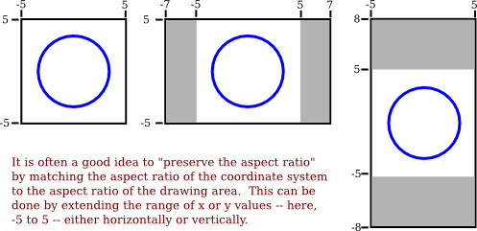
Aspect Ratio
Suppose that you want to use coordinates with limits left, right, bottom, and top, and that you do want to preserve the aspect ratio
In that case, depending on the shape of the display rectangle, you might have to adjust the values either of left and right or of bottom and top to make the aspect ratios match

Slide 14
Color Models
The colors on a computer screen are produced as combinations of red, green, and blue light
This method of specifying color is called the RGB color model
Three basic colors can produce a reasonably large fraction of the set of perceivable colors, but there are colors that you can see in the world that you will never see on your computer screen
The range of colors that can be produced by a device such as a computer screen is called the color gamut of that device
  The color gamut of a color printer is noticeably different than the color gamut of a screen

Slide 15
Color Models
The most common color model for computer graphics is RGB
The closely related color models HSV and HSL describe the same set of colors as RGB but attempt to do it in a more intuitive way
  HSV is sometimes called HSB, with the "B" standing for "brightness"
  HSV and HSB are exactly the same model
  The "H" in these models stands for "hue," a basic spectral color
    The value of H is often taken to range from 0 to 360, since the colors can be thought of as arranged around a circle with red at both 0 and 360 degrees
  The "S" in HSV and HSL stands for "saturation," and is taken to range from 0 to 1
    A saturation of 1 gives a "pure color," and decreasing the saturation is like adding more gray to the color
  "V" stands for "value," and "L" stands for "lightness"
    They determine how bright or dark the color is

Slide 16
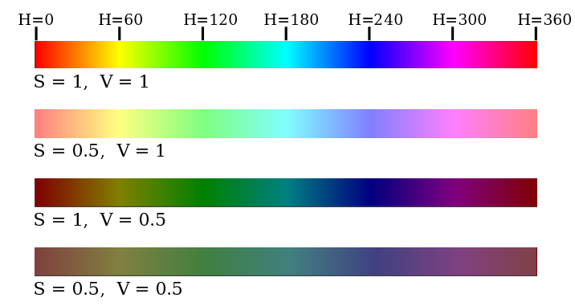
The HSV color model
Notes:
RGB/HSV Color Demo (hws.edu)

Slide 17
Color Models
Often, a fourth component is added to color models
The fourth component is called alpha, and color models that use it are referred to by names such as RGBA and HSLA
Alpha is usually used to represent transparency
Transparency determines what happens when you draw with one color (the foreground color) on top of another color (the background color)
Assuming that the alpha component ranges from 0 to 1, the color that you get can be computed as
  new_color = (alpha)*(foreground_color) + (1 - alpha)*(background_color)
This is called alpha blending

Slide 18
Shapes

Slide 19

Basic Shapes
In a graphics API, there will be certain basic shapes that can be drawn with one command
  In the WebGL API, for example, the only basic shapes are points, lines, and triangles
A simple one-pixel-wide line segment, without antialiasing, is the most basic shape
  Lines can have other attributes, or properties, that affect their appearance
(Left): three wide lines with no cap, a round cap, and a square cap
(Middle): three different styles of line joins: mitered, rounded, and beveled
(Right): four lines with different patters of dots and dashes

Slide 20
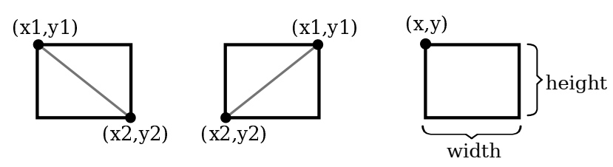
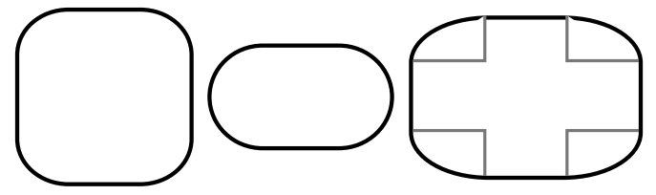
Basic Rectangular Shape
The basic rectangular shape has sides that are vertical and horizontal
A common variation on rectangles is to allow rounded corners

Slide 21
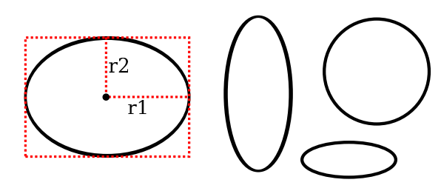
Basic Oval/Ellipse
If ovals are not available as basic shapes, they can be approximated by drawing a large number of line segments
Notes:
Approximating an Oval with Line Segments (hws.edu)

Slide 22
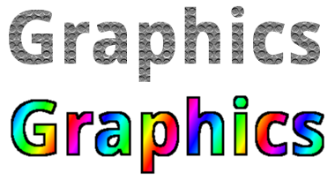
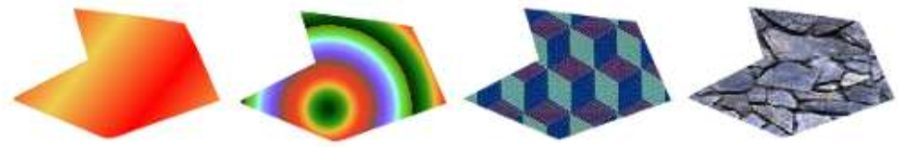
Stroke and Fill
Two ways to make a shape visible: stroke and fill
  Stroking a shape is like dragging a pen along its boundary
  Filling a shape means coloring all the points that are contained inside that shape
Shapes can be filled with a color, but other types of fill are possible, including patterns and gradients
A shape, filled with two gradients and two patterns
The string "Graphics" is filled with a pattern (top) and, filled with a gradient and stroked with solid black (bottom)

Slide 23
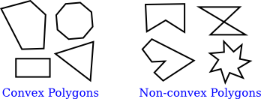
Polygons, Curves, and Paths
A polygon is a closed shape consisting of a sequence of line segments
  A convex polygon has the property that whenever two points are inside or on the polygon, then the entire line segment between those points is also inside or on the polygon

Slide 24
Polygons, Curves, and Paths
A polygon is a closed shape consisting of a sequence of line segments
  A simple polygon has the property that the polygon has no self-intersections
  A planar polygon means that all the vertices lie in the same plane
A path is a general shape that can include both line segments and curved segments
  Suppose that we want a path that represents the triangle with vertices at (100,100), (300,100), and (200, 200):
    createPath()
    moveTo( 100, 100 )
    lineTo( 300, 100 )
    lineTo( 200, 200 )
    closePath()

Slide 25
Polygons, Curves, and Paths
A path can contain other kinds of segments besides lines, e.g. an arc of a circle
Another type of curve is a Bezier curve, it can be used to create very general curved shapes
There are two kinds of Bezier curve in common use, cubic Bezier curves and quadratic Bezier curves
A cubic Bezier curve segment is defined by the two endpoints of the segment together with two control points

Slide 26
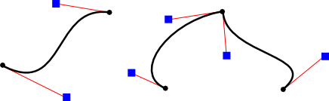
Polygons, Curves, and Paths
Figure above shows three cubic Bezier curve segments
The two curve segments on the right are connected at an endpoint to form a longer curve
The endpoints are shown as black dots and the control points as blue squares, with a thin red line connecting each control point to the corresponding endpoint

Slide 27
Transforms

Slide 28
Sub Section
Viewing and Modeling
Translation
Rotation
Combining Transformations
Scaling
Matrices and Vectors

Slide 29
Viewing and Modeling
Viewport: The rectangular area in which the image for 2D or 3D graphics is displayed
  The coordinates on the viewport are pixel coordinates or device coordinates
World coordinates: The coordinate system in which a scene is defined
Objects are defined in their own object coordinate system.
Modeling transformations are then applied to place objects into the scene; that is, they transform object coordinates to world coordinates

Slide 30
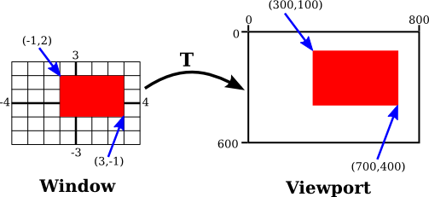
Coordinate Transforms
For 2D graphics, the world lies in a plane
View window: rectangular area in the plane to display in the image
A coordinate transform is used to map the window to the viewport
T(x,y) = ( 800*(x+4)/8, 600*(3-y)/6 )

Slide 31
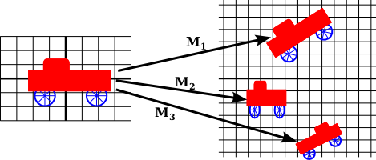
Modeling Transforms
The coordinates that we use to define an object are called object coordinates for the object
When we want to place the object into a scene, we need to transform the object coordinates that we used to define the object into the world coordinate system that we are using for the scene
The transformation that we need is called a modeling transformation

Slide 32
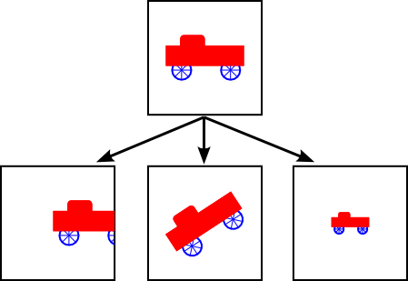
Two Ways for The Same Results

Slide 33
Affine Transform
Geometric transforms are a central concept in computer graphics
2D Transformations: if (x,y) represents the coordinates of some point before the transformation is applied, and (x1,y1) are the transformed coordinates
  x1 = a*x + b*y + e
  y1 = c*x + d*y + f
The transform is defined by the six constants a, b, c, d, e, and f.
  Note that this can be written as a function T, where:
    T(x,y) = ( a*x + b*y + e, c*x + d*y + f )
A transformation of this form is called an affine transform
  when it is applied to two parallel lines, the transformed lines will also be parallel
  if you follow one affine transform by another affine transform, the result is again an affine transform

Slide 34
Translation
If (x,y) is the original point and (x1,y1) is the transformed point, then the formula for a translation is
    x1 = x + e
    y1 = y + f
  where e is the number of units by which the point is moved horizontally, and f is the amount by which it is moved vertically
The translation would apply to everything that is drawn after the command is given

Slide 35
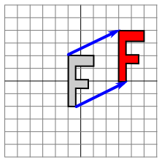
Translation
Suppose that you draw an "F" using coordinates in which the "F" is centered at (0,0)
If you say translate(4,2) before drawing the "F", then every point of the "F" will be moved horizontally by 4 units and vertically by 2 units before the coordinates are actually used, so that after the translation, the "F" will be centered at (4,2)
When you give the command translate(e,f), the translation applies to all the drawing that you do after that, not just to the next shape that you draw
If you apply another transformation after the translation, the second transform will be combined with the translation
  For example, if you combine translate(4,2) with translate(-1,5), the result is the same as a single translation, translate(3,7)
Also remember that you don't compute coordinate transformations yourself. The computer takes care of applying the transformation to the coordinates. You just need to understand what it does geometrically.

Slide 36
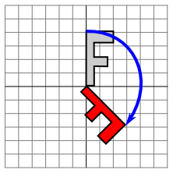
Rotation
A rotation transform rotates each point about the origin, (0,0)
Every point is rotated through the same angle
  angles can be measured either in degrees or in radians
    The 2D graphics APIs for Java and JavaScript use radians, but OpenGL and SVG use degrees
A rotation with a positive angle rotates objects in the direction from the positive x-axis towards the positive y-axis
  This is counterclockwise in a coordinate system where the y-axis points up
When rotation through an angle of r radians about the origin is applied to the point (x,y), then the resulting point (x1,y1) is given by
  x1 = cos(r) * x - sin(r) * y
  y1 = sin(r) * x + cos(r) * y
A 2D graphics API would typically have a command rotate(r) to apply a rotation
  The command is used before drawing the objects to which the rotation applies.
What is the angle of rotation in the picture above?

Slide 37
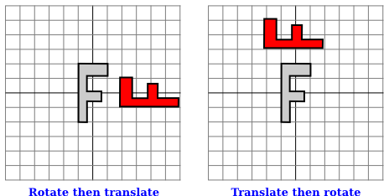
Transform Combination
Suppose that before drawing some object, you say
    translate(4,0)
    rotate(90)
    Assume that angles are measured in degrees
Which one is the correct illustration?
Write the code for the transformations to rotate a shape through an angle r about a point (p,q) instead of about the point (0,0)

Slide 38
Scaling
It can be used to make objects bigger or smaller
If a point (x,y) is scaled by a factor of a in the x direction and by a factor of d in the y direction, then the resulting point (x1,y1) is given by
    x1 = a * x
    y1 = d * y
Uniform scaling: A scaling transformation in which the scaling factors in all directions are the same
If you want to scale about a point other than (0,0), you can use a sequence of three transforms, similar to what was done in the case of rotation

Slide 39
Matrices and Vectors
The transforms that are used in computer graphics can be represented as matrices, and the points on which they operate are represented as vectors
If A and B are two N-by-N matrices, then they can be multiplied to give a product matrix C = AB
If A is an N-by-N matrix, and v is a vector of length N, then v can be multiplied by A to give another vector w = Av
The function that takes v to Av is a transformation, called a linear transformation
  Rotation and scaling are linear transformations, why?
  How about translation?

Slide 40
Matrices and Vectors
Suppose that A and B are N-by-N matrices and v is a vector of length N
We can form two different products: A(Bv) and (AB)v
  These two operations have the same effect
  We can multiply v by B and then multiply the result by A, or we can multiply the matrices A and B to get the matrix product AB and then multiply v by AB
If we want to apply a scaling followed by a rotation to the point v = (x,y), we can compute either R_{d}(S_{a,b}v) or (R_{d}S_{a,b})v
We could compute the product matrix RdSa,b once and for all, and then apply the combined transform to each point with a single multiplication
multiple transformations can be handled as efficiently as a single transformation

Slide 41

Matrices and Vectors
To bring translation into this framework, instead of representing a point in 2D as a pair of numbers (x,y), we represent it as the triple of numbers (x,y,1)
We can then represent rotation, scaling, and translation—and hence any affine transformation—on 2D space as multiplication by a 3-by-3 matrix
A sequence of transformations can be combined into a single transformation. The computer only needs to keep track of a single matrix, which we can call the "current matrix" or "current transformation."

Slide 42
Discussions

Slide 43
Penilaian Assignment 1

